Slide 1
E-COMMERCE COMPANY CASE STUDY
A MySQL Project

Slide 2
Project Overview
This project centers on applying SQL and data analysis techniques to an e-commerce company's operational database, simulating the vital role of a data analyst in a real business environment.
As part of the team, the task involves working with complex order data spanning various departments—such as sales, marketing, and supply chain—to extract actionable insights.
The case study challenges to optimize core business functions, like improving customer satisfaction, streamlining inventory management, and elevating sales performance, all through evidence-based recommendations driven by SQL queries and reporting.
By tackling a diverse range of business scenarios, this portfolio project demonstrates proficiency in MySQL, transforming raw data into strategic intelligence that empowers companies to thrive in competitive markets.

Slide 3
Problem 1: Market Segmentation Analysis
Identify the top 3 cities with the highest number of customers to determine key markets for targeted marketing and logistic optimization.

Slide 4
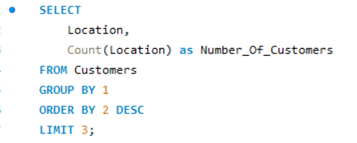
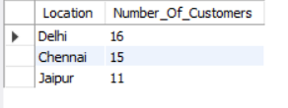
Solution:

Slide 5
Insights Drawn:
The analysis identifies Delhi (16 customers), Chennai (15 customers), and Jaipur (11 customers) as the top three cities with the highest number of customers. These cities represent the company’s strongest customer bases and should be considered priority markets for targeted marketing efforts and strategic logistical planning.
Focusing on these locations can help the business:
Maximize ROI on marketing campaigns by targeting regions with already high customer engagement.
Optimize distribution and logistics, as increasing operational efficiency in high-demand areas can reduce delivery times and costs.
Support expansion strategies, using these cities as anchor markets for new product launches or service enhancements.
Overall, these three cities serve as key hubs for strengthening market presence and improving operational efficiency.

Slide 6
Problem 2: Engagement Depth Analysis
Determine the distribution of customers by the number of orders placed. This insight will help in segmenting customers into one-time buyers, occasional shoppers, and regular customers for tailored marketing strategies.

Slide 7
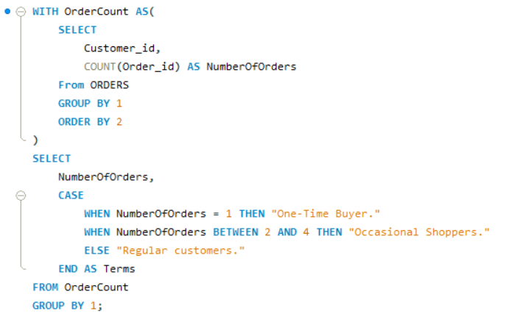
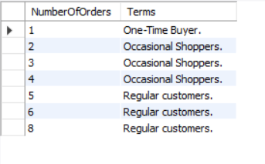
Solution:

Slide 8
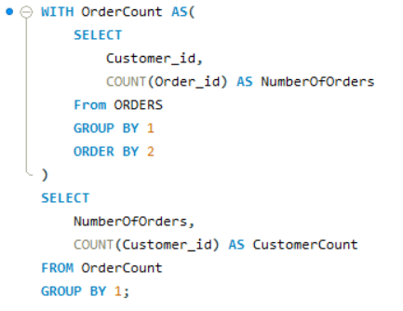
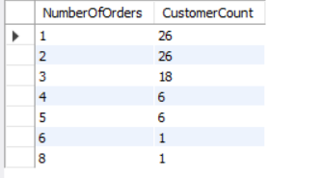
Solution:

Slide 9
Insights Drawn:
Most customers are one-time or light buyers (1–2 orders), showing a strong need for retention efforts.
A moderate group places 3–5 orders, indicating potential to nurture them into loyal customers.
Very few customers are high-frequency shoppers (6+ orders), making them valuable and worth targeted VIP treatment.
Overall pattern shows a long tail, where many buy rarely and only a small number buy frequently — highlighting opportunities to convert one-time buyers into repeat customers.

Slide 10
Problem 3: Purchase High-Value Products
Identify products where the average purchase quantity per order is 2 but with a high total revenue, suggesting premium product trends.

Slide 11
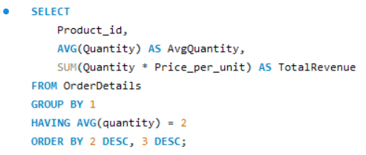
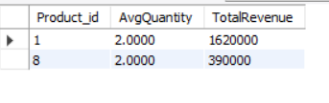
Solution:

Slide 12
Insights Drawn:
The query identifies products with an average purchase quantity of 2 per order but high total revenue.
This pattern suggests these items are premium or high-priced products, generating strong revenue despite low purchase volumes.
Product 1 stands out with significantly higher revenue, indicating high value or strong demand even at small quantities.
These products are strong candidates for:
Premium positioning
Focused marketing efforts
Strategic pricing adjustments
Inclusion in high-value promotional bundles

Slide 13
Problem 4: Category-Wise Customer Reach
For each product category, calculate the unique number of customers purchasing from it. This will help understand which categories have a wider appeal across the customer base.

Slide 14
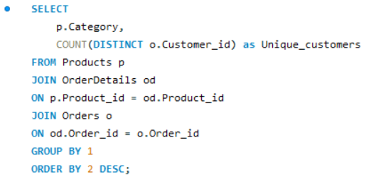
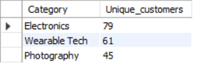
Solution:

Slide 15
Insights Drawn:
Electronics has the widest reach (79 customers) → strongest category in terms of customer appeal and engagement.
Wearable Tech attracts a moderate customer base (61 customers) → good interest but scope to expand through targeted campaigns.
Photography has the smallest unique customer base (45 customers) → niche segment; needs focused marketing or product bundling to boost traction.

Slide 16
Problem 5: Sales Trend Analysis
Analyze the month-on-month percentage change in total sales to identify growth trends.

Slide 17
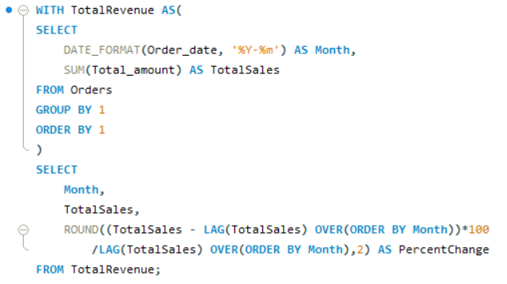
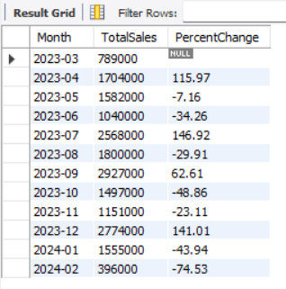
Solution:

Slide 18
Insights Drawn:
Sales fluctuate sharply month to month, indicating instability rather than a predictable growth pattern.
Large positive spikes, especially in July (+146%) and December (+141%), suggest strong seasonal or campaign-driven boosts.
Negative dips immediately after peak months show that these surges are not sustained, pointing to dependency on one-off events.
Early 2024 experiences significant declines, with February showing a steep –74%, signaling potential slowdown or absence of previous drivers.
Overall, the data reflects event-driven sales cycles rather than consistent organic growth, highlighting an opportunity to stabilize and smooth out monthly performance.

Slide 19
Problem 6: Average Order Value Fluctuation
Examine how the average order value changes month-on-month. Insights can guide pricing and promotional strategies to enhance order value.

Slide 20
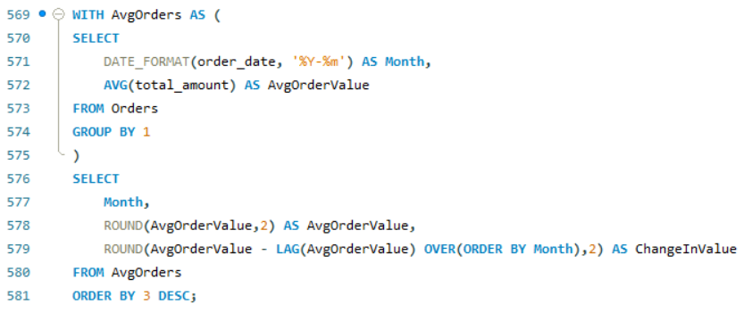
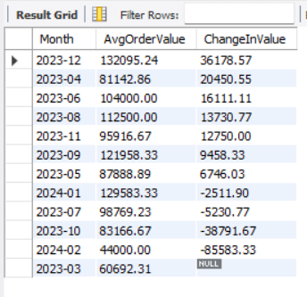
Solution:

Slide 21
Insights Drawn:
AOV(Average Order Value) fluctuates significantly month to month, showing inconsistent customer spending behavior.
Strong increases in months like Dec 2023 and Apr–Jun 2023 suggest periods where customers are willing to spend more—likely due to effective promotions or seasonal demand.
The sharp declines in early 2024 highlight a drop in order value, indicating weakened buyer intent or reduced promotional impact.
Overall, the pattern shows a need to stabilize AOV through consistent pricing strategies, value-driven bundles, or targeted promotions to maintain higher spend levels.

Slide 22
Problem 7: Inventory Refresh Rate
Based on sales data, identify products with the fastest turnover rates, suggesting high demand and the need for frequent restocking.

Slide 23
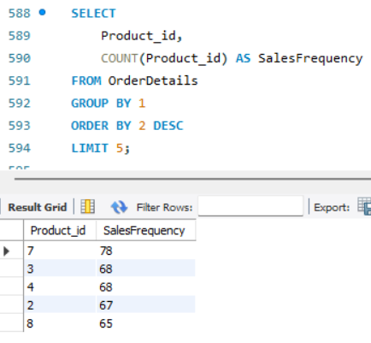
Solution:

Slide 24
Insights Drawn:
The top-selling products (IDs 7, 3, 4, 2, 8) show significantly higher purchase frequency than others, signaling that customers consistently prefer these items.
Their fast turnover indicates high and steady demand, making them critical for inventory management.
These products should be restocked more frequently and potentially featured in promotions, as they represent the core drivers of repeat sales and revenue stability.

Slide 25
Problem 8: Low Engagement Products
List products purchased by less than 40% of the customer base, indicating potential mismatches between inventory and customer interest.

Slide 26
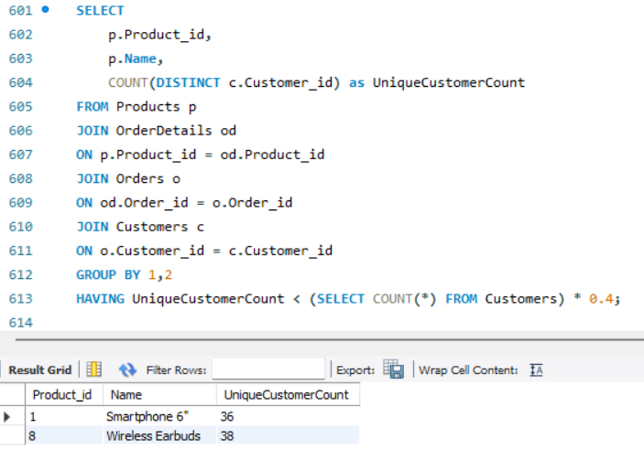
Solution:

Slide 27
Insights Drawn:
The products “Smartphone 6” (36 customers) and “Wireless Earbuds” (38 customers) are purchased by less than 40% of the total customer base, indicating low customer reach.
Despite being common product categories, their limited adoption suggests weak customer interest, poor targeting, or strong competition from alternatives.
These products may represent inventory inefficiencies, as they are not widely purchased across the customer base.
There is an opportunity to improve visibility and sales through better marketing, bundling, discounts, or recommendations.
Alternatively, consistently low engagement may indicate a need to re-evaluate product positioning, pricing, or even phase out underperforming items.

Slide 28
Problem 9: Customer Acquisition Cost
Evaluate the month-on-month growth rate in the customer base to understand the effectiveness of marketing campaigns and market expansion efforts.

Slide 29
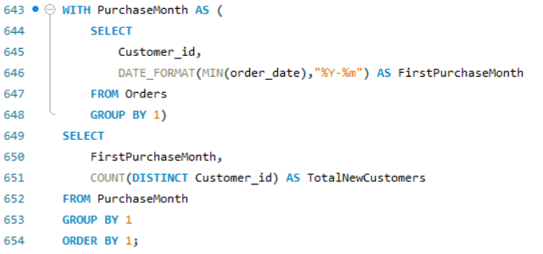
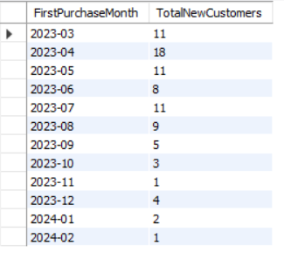
Solution:

Slide 30
Insights Drawn:
Customer acquisition peaks in April (18 customers), indicating a highly effective campaign or strong market activity during that period.
After April 2023, there is a fluctuating but overall declining trend, suggesting reduced marketing effectiveness or demand slowdown.
Mid-year months (May–August) in 2023 show moderate and stable acquisition, indicating consistent but not aggressive growth.
From September onward, there is a sharp drop in new customers, reaching as low as 1–3 customers, signaling weak acquisition efforts or market saturation.
Early 2024 continues with very low growth, indicating a need to reassess acquisition strategies.
Overall, the trend suggests initial strong growth followed by gradual decline, highlighting the need for renewed marketing campaigns and customer acquisition strategies.

Slide 31
Problem 10: Peak Sales Period Identification
Identify the months with the highest sales volume, aiding in planning for stock levels, marketing efforts, and staffing in anticipation of peak demand periods.

Slide 32
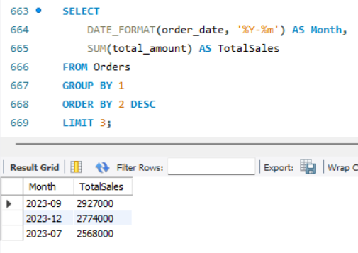
Solution:

Slide 33
Insights Drawn:
The top sales months—September 2023, December 2023, and July 2023—show distinct peaks in demand, indicating strong seasonal or event-driven spikes.
These months should be prioritized for higher inventory levels, stronger marketing pushes, and increased staffing, as they consistently generate the largest sales volumes.
Understanding these peak periods helps ensure the business is fully prepared to capitalize on high-demand cycles.

Slide 34
THANK YOU!
ANKITA DUTTA
Email ID: ankitadutta2411@gmail.com
Mobile No.: +91-8013691874

